Slide 1

CSE 316 - Peripheral and Interfacing Lab Project: Mini Piano Using Arduino
Submitted By:
Md. Abdur Rashid
ID: 19101008, Section: A1

Slide 2
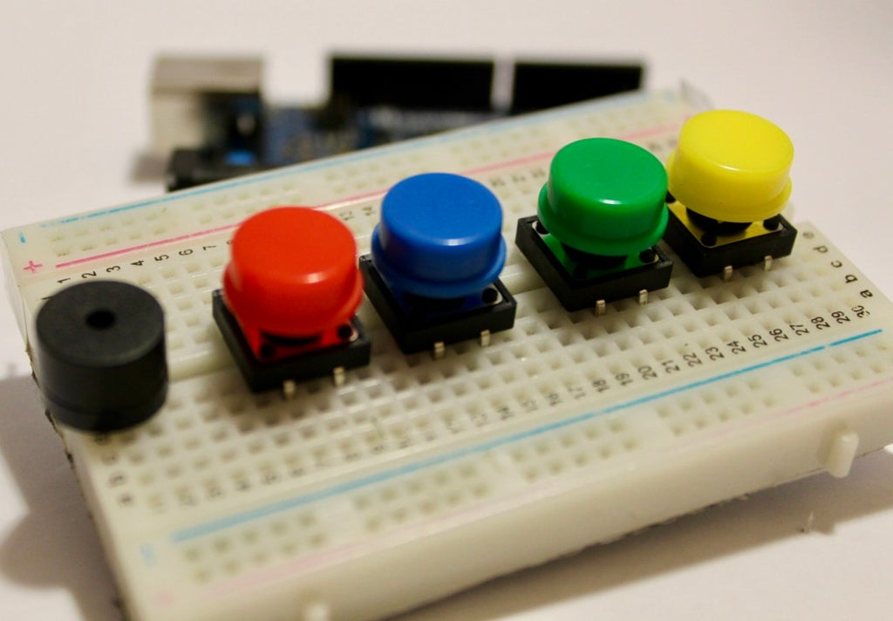
Content:
INTRODUCTION
REQUIRED EQUIPMENTS
ABOUT THE PROJECT
EFFECTS
A Mini Piano Using Arduino UNO

Slide 3
INTRODUCTION :
It is time to make some noise. on this project, I shall build a mini piano using Arduino UNO. This project is really easy and fun to play with.
REQUIRED EQUIPMENTS :
Arduino Uno
Pushbutton
Resistor
Jumper Wires
Speaker
Breadboard
A Mini Piano Using Arduino UNO

Slide 4
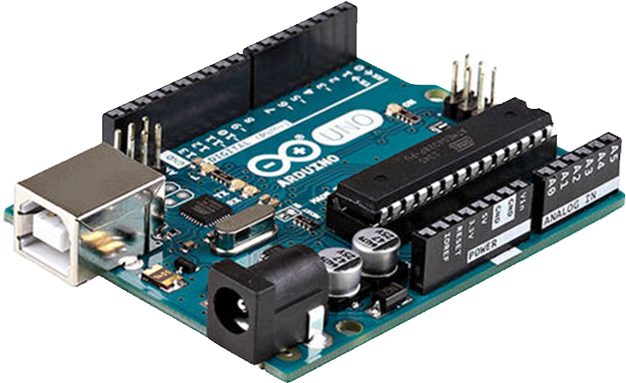
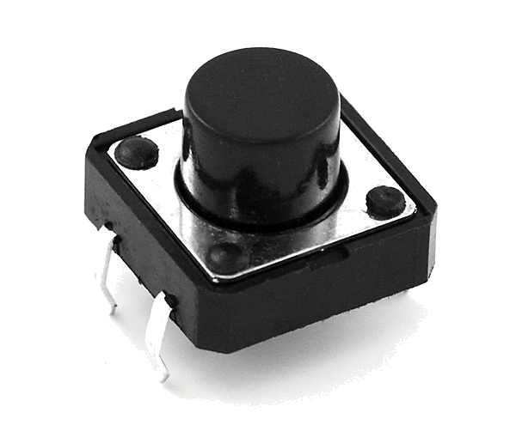
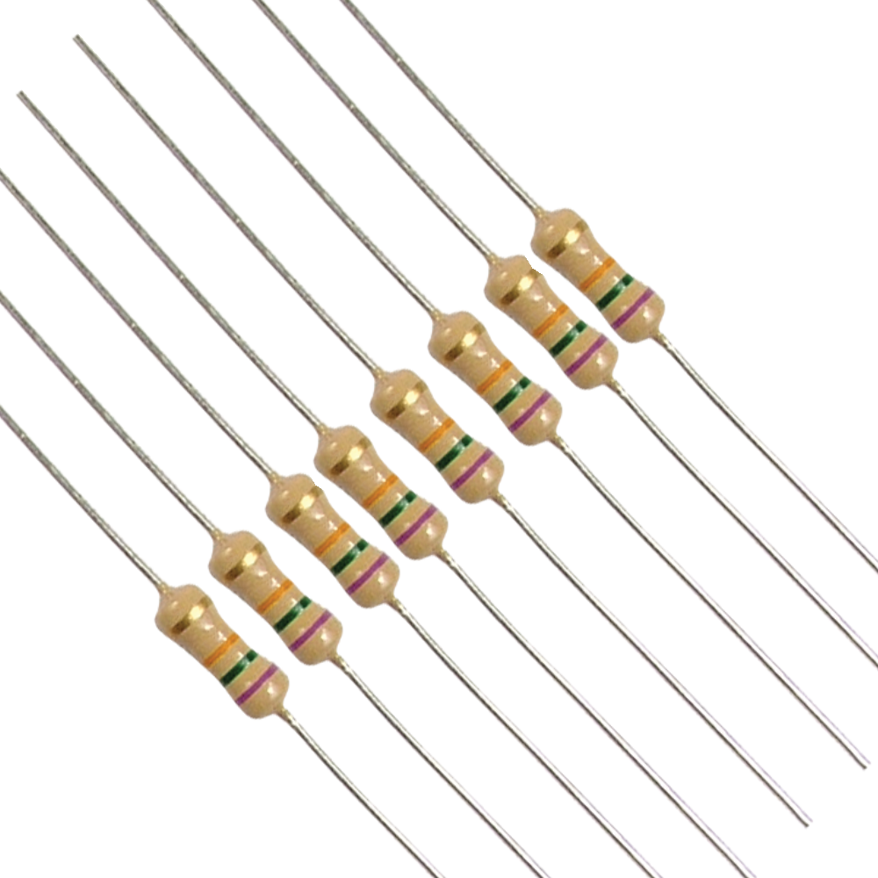
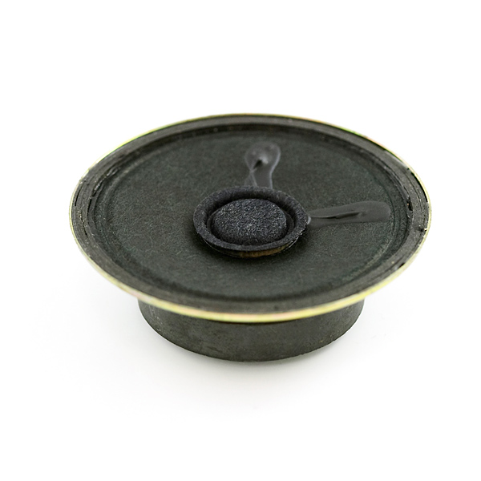
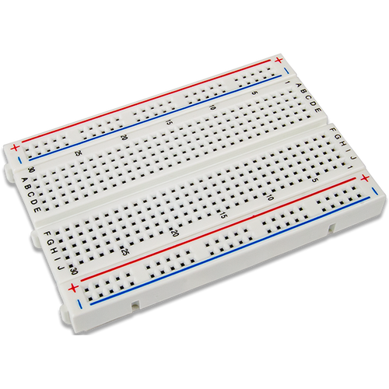
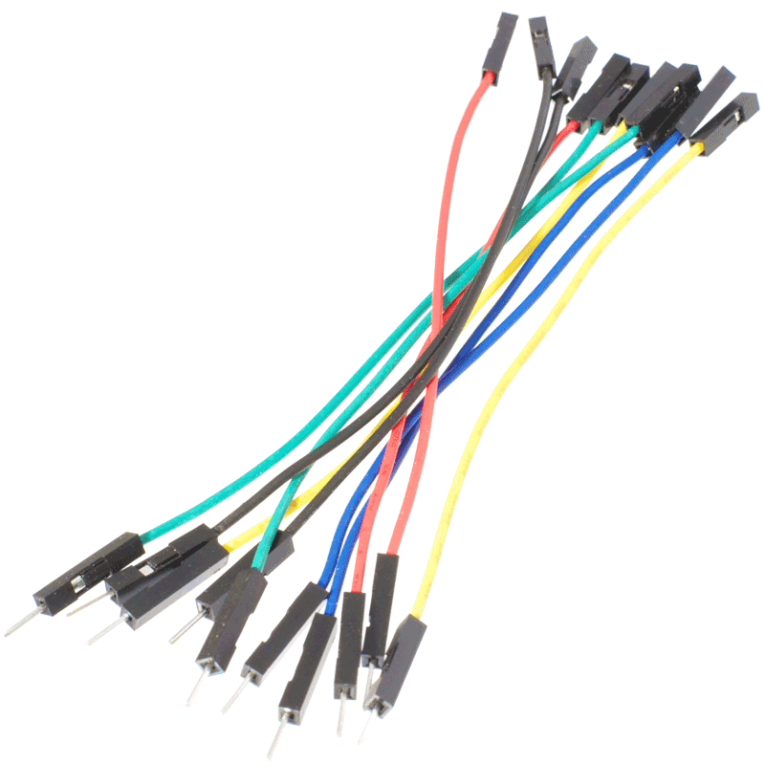
REQUIRED EQUIPMENTS :
PUSHBUTTON
RESISTOR
ARDUINO UNO
SPEAKER
BREADBOARD
JUMPER WIRES

Slide 5
ABOUT THE PROJECT:
We know that Arduino is capable of producing PWM (Pulse Width Modulation) signals. We will be using this feature of Arduino to generate tones. On this project, an Arduino uno will be connected with a speaker and some buttons. Each time when we press a button, Arduino makes a sound of a specific frequency for each button. The frequencies correspond to specific music notes.
EFFECTS:
This Arduino based Piano project comes under the category of fun projects, this project doesn’t have any real world applications (at least not directly) but can be used to understand certain features of Arduino.

Slide 6
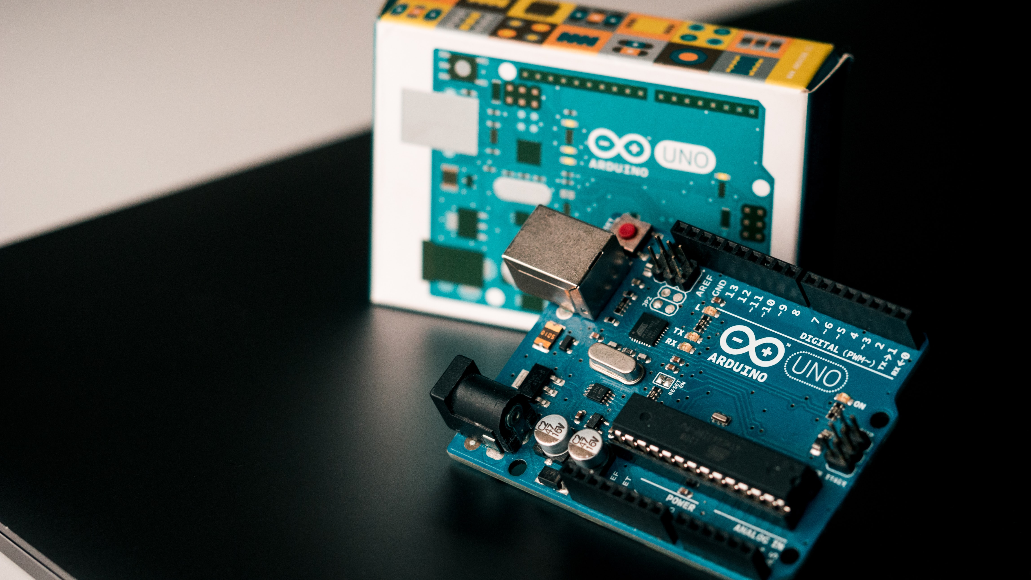
Thank You

